Slide 1
CMPE 272 TERM PROJECT
Cross Domain Online Enterprise Marketplace

Slide 2
Team Members : Group 11
Belinda Terry (13785668)
Jayasurya Pinaki (14491854)
Shubham Singh (14153009)
Sudhanshu Shekhar (14535079)
Varsha Pothaganahalli Jairam (13931242)

Slide 3
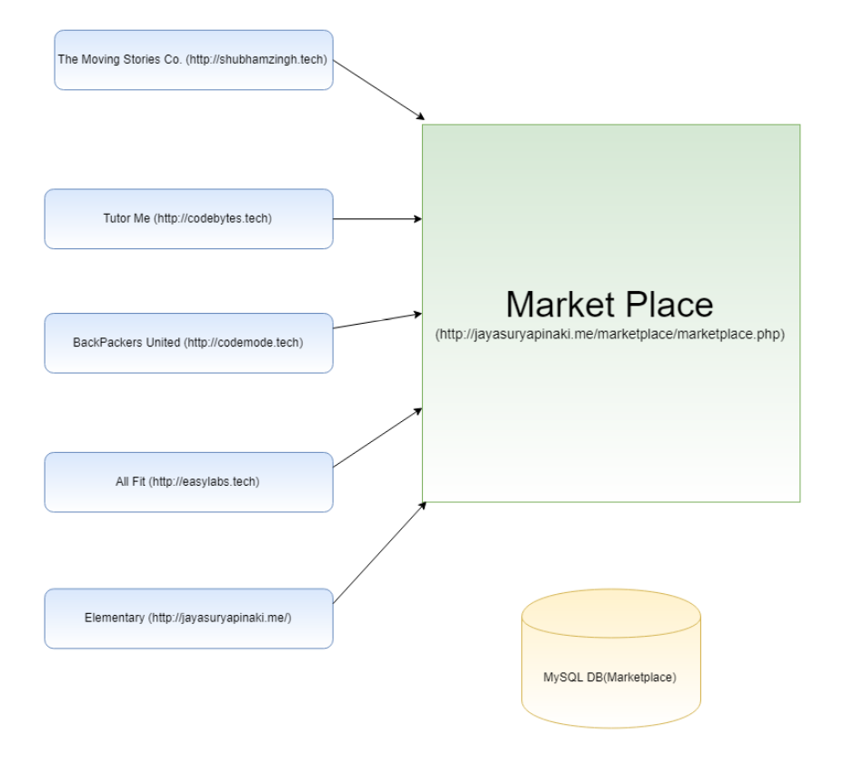
Architecture
All the websites are connected to the marketplace.
The user can go the marketplace and check out the products from all the websites.i

Slide 4
Basic Features
Creation of user for the whole marketplace.
Ability for the user to add a review and rating for any product/service offered in the market place.
Presentation of the top five products/services in each member company.
Presentation of the top five products/services in the whole market place.

Slide 5
Extra Features
Google login.
Add balance to wallet.
Multiple ways of rating.
Sort the products with respect to 5 different criteria: Top 5 Visited, Best Rated, Top 5 Rated based on Quality, Experience, Overall, Top 5 sorted by price.
Buy product.
Order Invoice sent via mail.

Slide 6
Challenges Faced
Integration and Testing.
Rendering cURL responses of all websites.

